Slide 1

CLAUDE ONBOARDING · STUART DIGITAL
Claude
Onboarding Kit
A guided setup that makes Claude useful for your real work.
Context. Skills. First useful result.
01

Slide 2

THE STARTING GAP
Claude starts blank.
Your work does not.
Without setup, every conversation starts with the same explanation: your role, your company, your standards and how you want the work written.
Blank
Repetitive
Inconsistent
It does not know your world yet.
You explain the same context again.
Every prompt starts from scratch.
02

Slide 3

THE PROMISE
One guided setup.
A useful working partner.
The pack interviews you once, captures how you work, then builds a practical toolkit around the jobs you actually need done.
Set up. Learn. Ship.
03

Slide 4


THE SYSTEM
Personal context and practical skills,
connected.
YOUR CONTEXT
YOUR TOOLKIT
Claude learns your role, company, standards and voice.
You choose skills for reports, meetings, letters and trackers.
04

Slide 5

BETTER FIRST DRAFTS
Teach it once.
Keep the context.
Your role, company, brand and preferred voice load into the work. Each new task begins informed, without a briefing from zero.
Less explaining. Better first drafts.
05

Slide 6


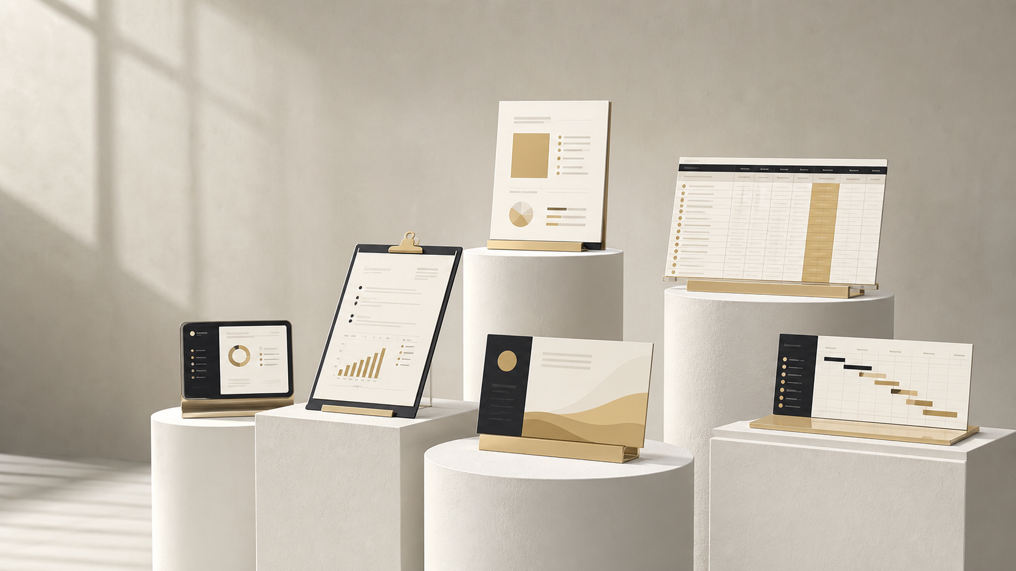
THE KIT, AT A GLANCE
Three parts. One working system.
01
Setup pack
02
Skills toolkit
03
Cowork project
A guided interview captures who you are.
Build only the capabilities you will use.
Turn real files into finished deliverables.
06

Slide 7

WHAT MAKES IT DIFFERENT
Not another prompt list.
A working system.
The setup is personal, the skills are practical, and each one is adapted to the user instead of copied as a generic recipe.
01 Personal working context
02 Brand and voice captured
03 Skills chosen deliberately
07

Slide 8

THE OPPORTUNITY
Built for one person.
Ready for a team.
A repeatable onboarding standard can get every new user productive while preserving their role, preferences and way of working.
One standard. Personal working styles.
08

Slide 9

CLAUDE ONBOARDING KIT
Your context.
Your toolkit.
Your next useful result.
A guided route from a blank Claude workspace to confident, repeatable daily work.
Stuart Digital
09

